Slide 1
First 5 Center PSP Webinar Series Demystifying Medi-Cal to Support Young Children & Families
Tuesday, October 27th, 9:00 – 10:30 AM PT
Donna Cohen Ross
Independent Advisor to
Center for the Study of Social Policy
donna@dcrinitiatives.com
Jocelyn Guyer
Managing Director
Manatt Health
jguyer@manatt.com
Tara Ficek
Director, Health Systems
First 5 LA
ficek@first5la.org
Alice Lam
Managing Director
Manatt Health
alam@manatt.com

Slide 2
Agenda
Welcome
Overview of Medi-Cal
Medi-Cal Managed Care Delivery System
Example of County Partnership with Medi-Cal Managed Care Plan
Wrap-Up & Next Steps

Slide 3
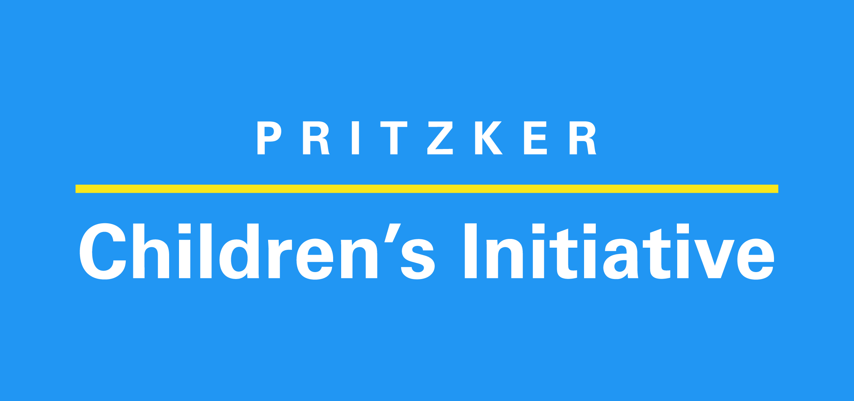
Pediatrics Supporting Parents (PSP) California Overview
PSP CA is supported by three funders to leverage Medi-Cal and pediatric primary care to better support the healthy social and emotional development of young children in California.
The PSP CA initiative will feature a Medi-Cal options paper spotlighting recommended strategies and implementation approaches to improve the well-being of young children in California and better support their families.

Slide 4
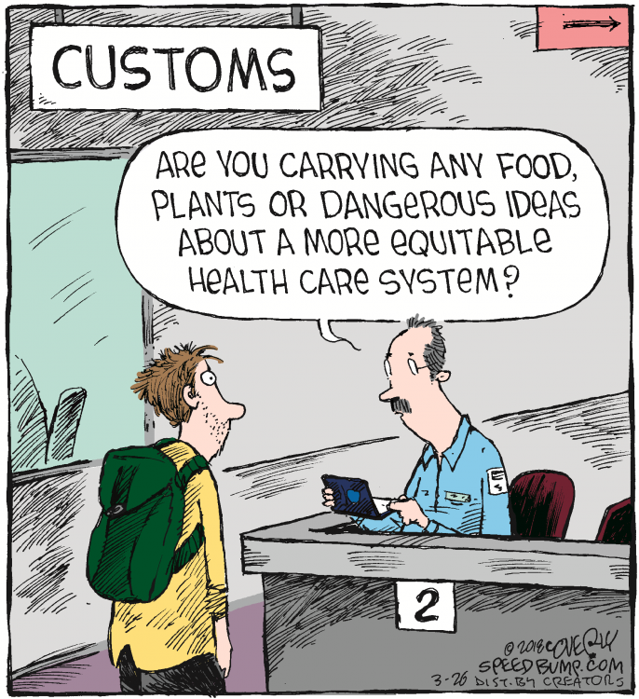
Zoom Poll: Overview of Medi-Cal

Slide 5
Overview of Medi-Cal

Slide 6
Medicaid in California: Medi-Cal
Medi-Cal is California’s Medicaid program and provides health coverage to over 10 million Californians. Since 2013, Medi-Cal covers children and pregnant women whose coverage was formerly financed by the State’s Children’s Health Insurance Program (CHIP) (formerly known as Healthy Families).
2020 Medi-Cal Income Eligibility Limits
(% of the Federal Poverty Level (FPL))
Medi-Cal Coverage
208% FPL
266% FPL
142% FPL
266% FPL
51% of births funded by Medi-Cal
133% FPL
266% FPL
53% of children under age five enrolled in Medi-Cal
213% FPL
322% FPL
138% FPL
* Family of three includes the unborn child
Sources: Kaiser Family Foundation: Medicaid/CHIP Eligibility Limits; Kaiser Family Foundation: Medicaid in California; Kaiser Family Foundation: Births Financed by Medicaid; CHHS Open Data; KidsCount 2019; HealthCare.Gov: FPL 2020.

Slide 7
Federal & State Agencies with Medi-Cal Oversight Responsibilities
Centers for Medicare & Medicaid Services (CMS): Federal agency authorized to oversee Medicaid
DHCS is California’s State Medicaid Agency. DHCS submits contracts, federal waivers, and materials to CMS for review, negotiations, and approval.
California Health & Human Services (CHHS)
Department of Health Care Services (DHCS): Administers Medi-Cal and oversees managed care plans (MCPs)
Department of Managed Health Care (DMHC): Protects consumers’ healthcare rights in MCPs
California Counties: Local human service agencies conduct Medi-Cal eligibility determinations

Slide 8
Medicaid Authorities & State Program Administration
Medicaid is authorized by the Social Security Act (SSA). Federal statute, regulations, and sub-regulatory guidance establish requirements and options for states.
Federal Statute
Federal Regulations
Federal Guidance
State Program Administration
SSA Title 19
SSA Title 21
SSA Section 1115
Code of Federal Regulations Title 42: Public Health
State Medicaid Director Letter (SMDL)
State Health Official Letter (SHO)
Medicaid & CHIP Informational Bulletin (CIB)
Frequently Asked Questions (FAQs)
Medicaid & CHIP State Plan
State Plan Amendment (SPA)
Medicaid Managed Care Contract
Requires Federal Approval
California currently has a Section 1115 waiver (Medi-Cal 2020 Demonstration) expiring in December 2020. The State has asked CMS to extend the waiver through December 2021, after which DHCS plans to implement CalAIM – pending CMS approval – a new, five year demonstration currently envisioned to focus on high-cost, high-utilizing adults.

Slide 9
Medicaid’s Commitment to Children: Early and Periodic Screening, Diagnostic, and Treatment (EPSDT)
Federal law requires the delivery of comprehensive pediatric healthcare services to all enrolled children and youth under 21 through the EPSDT benefit. Medi-Cal covers CHIP, resulting in all enrolled children receiving the full EPSDT benefit.
Early and Periodic Screenings | Diagnostic Services | Treatment Services
Regularly scheduled comprehensive health and developmental screenings Comprehensive unclothed physical exams Appropriate vision and hearing tests, immunizations, and laboratory tests Dental screenings and referrals Health education | Medically necessary diagnostic services when a risk is identified, including follow-up testing, evaluation, and referrals | Timely treatment services as determined by child health screenings (which includes treatment services medically necessary to correct or ameliorate defects and address physical and behavioral health conditions)
If a service or device is medically necessary to correct or ameliorate a condition and could be covered under Medicaid, then it must be provided, even if that service or device is not identified in the Medicaid State Plan. Notably, California and MCPs may not impose hard or fixed limits on specific services related to EPSDT.
Sources: SSA § 1905(r); 42 CFR § 441.56; CMS EPSDT Guide for States: Coverage in the Medicaid Benefit for Children and Adolescents.

Slide 10
Medi-Cal Financing
Medicaid is a matching program, where the “non-federal share” is provided by the State, counties, or other entities (subject to federal rules) to draw down “federal share” at a state-specific “federal medical assistance percentage (FMAP)” – or “match rate.”
Federal Funding
California’s Medicaid FMAP is 50 percent for most Medi-Cal enrollees, meaning for every $0.50 spent on a Medi-Cal enrollee, the federal government matches $0.50
The CARES Act increased California’s Medicaid FMAP to 56.2 percent through the end of the quarter that the Public Health Emergency expires (March 31, 2021)
California’s Medicaid FMAP is 90 percent for Affordable Care Act (ACA) adult expansion population
California’s CHIP enhanced FMAP (eFMAP) is 65 percent for CHIP enrollees
The CARES Act increased California’s CHIP eFMAP to 69.34 percent
Other Medicaid activities’ federal share range 50 – 100 percent, depending on activity
Medi-Cal Spending
For the non-federal share, at least 40% must be financed by State government sources and up to 60% may come from local government sources.
Medi-Cal spent $99 B in FY 2018 – 2019
$62.4 B (63 percent) funded by federal government
$20.8 B (21 percent) funded by State’s General Fund (accounted for 15 percent of the General Fund, the second highest behind K-12 spending)
$15.8 B (16 percent) other State and local funds
Sources: Kaiser Family Foundation: FMAP for Medicaid and Multiplier; California Health Care Foundation: 2019 Edition – Medi-Cal Facts and Figures; State Health & Value Strategies: Federal Declarations and Flexibilities Supporting Medicaid and CHIP COVID-19 Response Efforts Effective and Expiration Dates.

Slide 11
Zoom Poll: Medi-Cal Managed Care Delivery System

Slide 12
Medi-Cal Managed Care
Managed care is Medi-Cal’s primary delivery system in California’s 58 counties, with over 80 percent of enrollees receiving care through Medi-Cal managed care, as opposed to fee-for-service (FFS). California has six Medi-Cal managed care models operating statewide:
DEL
NORTE
Medi-Cal Managed Care County Models
SISKIYOU
MODOC
Two-Plan. DHCS contracts with a local initiative, county organized prepaid health plan and a commercial plan.
County Organized Health Systems (COHS). County Board of Supervisors may establish a commission to negotiate a COHS contract with DHCS, with all enrollees in the same plan.
Geographic Managed Care. DHCS contracts with several commercial plans.
Regional Model. DHCS contracts with two commercial plans in rural counties.
Imperial County. DHCS contracts with two commercial plans in Imperial County.
San Benito County. Beneficiaries may choose between a commercial plan or FFS.
TRINITY
SHASTA
LASSEN
HUMBOLDT
TEHAMA
MENDOCINO
PLUMAS
GLENN
BUTTE
SIERRA
COLUSA
YUBA
NEVADA
LAKE
SUTTER
PLACER
YOLO
EL DORADO
NAPA
SACRA- MENTO
AMADOR
ALPINE
SONOMA
SOLANO
CALAVERAS
MARIN
CONTRA COSTA
SAN JOAQUIN
TUOLUMNE
SAN
FRANCISCO
ALAMEDA
STANISLAUS
MARIPOSA
MONO
SAN
MATEO
SANTA
CLARA
MERCED
MADERA
SANTA
CRUZ
SAN
BENITO
FRESNO
INYO
MONTEREY
KINGS
TULARE
SAN LUIS
OBISPO
KERN
SANTA BARBARA
SAN BERNADINO
VENTURA
LOS ANGELES
ORANGE
RIVERSIDE
SAN DIEGO
IMPERIAL
Sources: DHCS: Medi-Cal Managed Care Models; DHCS: Medi-Cal Managed Care Program Fact Sheet.

Slide 13
Medi-Cal Managed Care Populations and Benefits
Populations
Carved-Out Populations
Dual eligibles (Medicare & Medicaid)
Children in foster care
Individuals with long-term care and services
Children
Pregnant women
Parents/caretakers
Adults without dependents
Seniors and people with disabilities who are not enrolled in Medicare
Benefits
Carved-Out Benefits
Substance use disorder treatment
California Children’s Services for seriously ill/disabled children in certain counties
Dental services
Long-term services and supports
Long-term care
EPSDT benefit
Preventive and wellness services
Physician services
Pregnancy-related services
Inpatient and outpatient hospital services
Behavioral health services (specialty behavioral health services are provided by counties through Specialty Mental Health Plans (SMHPs)
Prescription drugs
Laboratory and X-ray services
Emergency services
Sources: California Health Care Foundation: 2019 Edition – Medi-Cal Facts and Figures.

Slide 14
Medi-Cal Managed Care Payment
DHCS contracts with Medi-Cal MCPs who bring a network of providers for services, care, and treatment to Medi-Cal enrollees. CMS, DHCS, and MCPs do not deliver care to beneficiaries.
Managed Care Payment Structure
MCPs accept a capitated payment or rate – approved by CMS – to cover contracted services for beneficiaries
Consumers receive part or all of Medicaid covered services from providers that are paid by a MCP that is under contract with California
By passing risk off to MCPs, California has greater budget predictability
Contracts, Capitated Payments
Medi-Cal MCPs
Contracts, Provider Payments
Primary Care & Specialists
Clinics & Hospitals
Other Providers (i.e., First 5s)
Delivery of Care & Services
Medi-Cal Beneficiaries

Slide 15
MCP Delegation Continuum
MCPs are accountable for beneficiaries’ health outcomes and monitor the service utilization, coordinate service delivery, and monitor outcomes.
No Delegation / 100% Direct Contracting
Delegation to Multiple Plans, Independent Practice Associations (IPAs) / Medical Groups, and Hospitals
Primary MCP
Medi-Cal MCPs
Medi-Cal MCP
Local SMHP
IPA 2
IPA 1
Hospital A
Individual Providers
Individual Providers

Slide 16
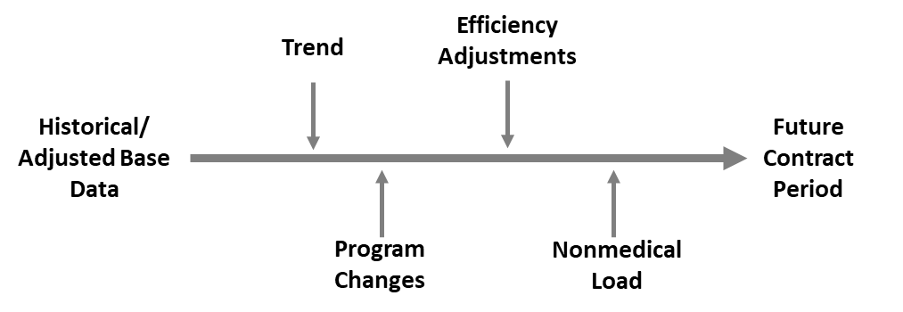
Medi-Cal Rate Setting Process
California has some of the lowest Medicaid reimbursement rates nationwide, with payments to plans and providers remaining a point of tension.
Medi-Cal Rate Setting Process
Medicaid Provider Reimbursement Rates for Well Child Visits*
Well Child Visit | CPT Codes | California | Oregon | Michigan
Infant (<1 year) | 99381 (new patient) 99391 (est. patient) | $45.33 $34.69 | $54.10 – 84.30 $49.58 – 76.14 | $86.72 $65.83
Young Child (ages 1 – 4) | 99382 (new patient) 99392 (est. patient) | $47.13 $37.39 | $57.78 – 88.33 $59.07 – 81.08 | $93.36 $73.74
* FFS fee schedule services as a reference point for Medicaid managed care rates
Sources: American Academy of Pediatrics: Coding for Pediatric Preventive Care 2020; DHCS: Medi-Cal Rates Download, October 2020; Oregon Health Authority: Medical-Dental Fee Schedule, October, 2020; Michigan Department of Health and Human Services: Child and Adolescent Health Center & Programs Fee Schedule, July 2020; California Health Care Foundation: Intended Consequences, Modernizing Medi-Cal Rate Setting to Improve Health and Manage Costs.

Slide 17
Realignment in California
There have been a number of realignments in California impacting Medi-Cal spending and county responsibilities, starting in 1991 when the State legislature began shifting fiscal and programmatic responsibility for many Medi-Cal services from the State to the counties.
1991 Realignment
Transferred significant program responsibility from the State to the counties
Changed how the State and counties share costs of certain social services programs
Transferred health and mental health service responsibilities and costs to the counties
2011 Realignment
Merged county behavioral health departments with previous DHCS operated behavioral health program
Created 58 different county-administered behavioral health programs for enrollees with specialty mental health services – known as specialty mental health programs (SMHPs)
Transferred foster care, child welfare services, adoptions, and adult protective services programs from the State to the counties
A 2019 California Legislature Legislative Analyst Office (LAO) report found that the “1991 realignment no longer meets many LAO principles,” noting that the share of costs to counties exceeds program costs and no longer stands as a successful state-county fiscal partnership
Sources: CA LAO: Assessing the Governor’s 1991 Realignment Proposals, March 2019; California State Association of Counties: Chapter 6, Health Services, February 2019; California State Association of Counties: Chapter 11, Human Services, February 2019.

Slide 18
Medi-Cal Specialty Behavioral Healthcare Services
Established through the 2011 Realignment, each California county has a specialty mental health plan (SMHP), which is a Medi-Cal behavioral health services managed care program for adults with serious mental illness (SMI) and children with serious emotional disturbance (SED).
Financially, counties are responsible for the non-federal share of the SMHPs’ costs, effectively creating a cap on behavioral services for enrollees with SMI/SED.
Beneficiaries with mild-to-moderate behavioral health needs (i.e., outpatient therapy, medication) receive care through Medi-Cal MCPs, whereas beneficiaries with SMI/SED (i.e., inpatient treatment) are treated through the SMHP.
SMHPs and Medi-Cal MCPs are required to design and implement a memorandum of understanding (MOU), detailing covered services and populations, care coordination requirements, and oversight responsibilities of the MCP and SMHP.
Unclear guidance, missed diagnoses, and ambiguity amongst providers creates a lack of clarity on when a child’s social and emotional health concern qualifies as mild-to-moderate versus a specialized mental health service, making it difficult for families to identify how to secure behavioral healthcare for their children.
Sources: California Counties: Chapter Six, Health Services; DHCS: All Plan Letter 18-015: Memorandum of Understanding Requirements for Medi-Cal Managed Care Plans & Attachment 2; California Health Care Foundation: The Circle Expands – Understanding Medi-Cal Coverage of Mild-to-Moderate Mental Health Conditions.

Slide 19
Medi-Cal Managed Care Policy Tools
Medi-Cal MCP
Contract
DHCS All Plan Letter
(APL)
DHCS Policy and
Procedure Letter (PPL)
DHCS has broad flexibility to require or incentivize MCPs to implement initiatives aimed at pediatric populations
DHCS issues APLs to provide instructions and policy updates to Medi-Cal MCPs
DHCS issues PPLs to notify Medi-Cal MCPs of important details
DHCS Competitive Reprocurement of Medi-Cal MCPs
In September 2020, the agency accepted responses to a Request for Information (RFI) to inform the development of the draft Request for Proposal (RFP) expected in January 2021. Childhood advocates – including the First 5 Center for Children’s Policy – requested initiatives be included in the next Medi-Cal MCP contract to improve young children’s health and well-being. MCPs will submit responses to the RFP in 2021 with contracts effective in January 2024.
Sources: DHCS: APLs 1998 – 2020; DHCS: Administrative Claiming PPLs 1996 – 2020; DHCS: Medi-Cal Managed Care RFP Schedule by Model Type; DHCS: RFI #20-001.

Slide 20
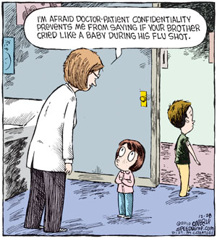
Zoom Poll: County Partnerships with MCPs

Slide 21
Tara Ficek
Director, Health Systems
First 5 LA
tficek@first5la.org

Slide 22
Impacting Systems Change through Partnerships with Medi-Cal Managed Care Plans in Los Angeles County
Tara Ficek, MPH
Tina Chinakarn, MPH
October 27, 2020

Slide 23
Why are Medi-Cal Managed Care Partners critical to improving maternal and child outcomes?
Recognition of the importance of “social determinants of health”
State is increasingly embedding accountability for member health within plans Examples: AB 1004 (enacted 2019), AB 2193 (enacted 2019)
Current and upcoming state initiatives provide opportunities to influence Medi-Cal requirements, informed by our local experience and relationships with service providers and health plans
California Advancing and Innovating Medi-Cal (CalAIM) implementation
Reprocurement schedule
ACEs Aware Initiative

Slide 24
LA County’s Medi-Cal System: Two Plan Model
L.A. Care and its partners cover 54% of children 0-5 in Los Angeles County.

Slide 25
First 5 LA’s Evolving Health Plan Partnerships
Present: Opportunistic
Future: Collaborative Partnerships
Past: Philanthropic
Healthy Kids initiative—insurance coverage
Community Benefits partnership (oral health)
Health Plans & County Department Meeting
LA Care pilot for Screening and Linkage
Implicit Bias Training
Cherished Futures
Home Visiting auto-referral
ACEs Aware grant
Promise Blue Shield pilot for Home Visiting
Pediatrics Supporting Parents Initiative

Slide 26
Current Involvement with Local Medi-Cal Plans
Bi-Monthly MCO and Health-Related County Dept Meeting
> F5LA role: convener, facilitator
Targeted 1 on 1 Plan Engagement and Pilot Exploration
> F5LA role: catalyst
Established Pilots: developmental screening and linkage to care, home visiting
> F5LA role: co-implementer, funder

Slide 27
Lessons Learned/Challenges
Data
- Access, ownership, use of data, HIPAA oversight
Contractual Considerations
- Reporting requirements, proprietary rights
Relationship building across the plan
Commitment from plan in writing
Transparency of intent
Sustainability/policy change

Slide 28
Discussion

Slide 29
Thank you! Contact Information: tficek@first5la.org tchinakarn@first5la.org

Slide 30
Save the Date!
Join us at our next two
First 5 Center PSP CA webinars:
Preventive Mental Health Services
in Medi-Cal
Early Identification and Intervention in
Medi-Cal
Monday, November 9th
12:30 – 2:00 PM PT
Wednesday, December 9th
10:45 – 12:00 PM PT

Slide 31
Thanks & Be Well!

Slide 32
Appendix

Slide 33
Medicaid Federal Requirements & Options
Feature | Mandatory Requirements | Options
Covered Populations & Eligibility Levels | Children up to 133% FPL Pregnant women & postpartum women for 60 days up to 133% FPL Parents and caregivers* Children in foster care Former foster care children up to age 26 Children and adults receiving supplemental security income (SSI)* Elderly individuals receiving SSI Refugees and asylees | Low-income children above 133% FPL* Low-income pregnant women up to 185% FPL* Low-income postpartum women for more than 60 days* Non-disabled, non-pregnant adults ages 19-65 up to 138% FPL* Medically needy individuals up to 133% FPL Specific diagnoses (e.g., Breast or cervical cancer, tuberculosis)* Family planning services for non-pregnant women*
Covered Services | EPSDT benefit Inpatient and outpatient hospital services Laboratory and x-rays Physician services Home health services Pediatric or family nurse practitioner services Nurse midwife services Family planning services and supplies Tobacco cessation for pregnant women Federally qualified health centers, rural health clinic centers, free standing birth centers Non-emergency medical transportation Nursing facility services (ages 21 and older) | Included, but not limited to: Pharmaceutical coverage (all states opt to cover drugs) Dental services for adults Substance abuse rehabilitation Eyeglasses and optometry services Speech, hearing, and language disorder services Targeted case management
Delivery Model | States must pick at least one delivery system. | Medicaid Managed Care, Fee-For-Service, or both
Financing & Payment | Medicaid services’ State share between 50 – 83%, with at least 40% coming from State; remainder can come from local governments General Medicaid administrative activities’ State-share 50% | Other Medicaid administrative activities (i.e., translation services, MMIS operations) have higher match up to 100%
As of January 2020, California has expanded eligibility to all children and young adults regardless of immigration status, through age 25. California leverages these generous eligibility standards using State-only dollars to fund this expansion.
* Income eligibility limits vary by state
Sources: Medicaid & CHIP Payment & Access Commission (MACPAC): Eligibility; Federal Requirements & State Options for Eligibility; Mandatory & Optional Benefits; Provider Payment & Delivery Systems; Financing.

Slide 34
Medicaid Authorities & State Program Administration
Medicaid Authority | Authority Details
Federal Statute | Social Security Act Title XIX. Authorizes Medicaid and the federal-state matching. Social Security Act Title XXI. Authorizes states’ CHIP programs and federal-state matching. Social Security Act § 1115. Permits states to seek permission from HHS Secretary to waive certain federal requirements and implement demonstration projects to promote the goals of Medicaid.
Federal Regulations | Code of Federal Regulations Title 42: Public Health. The set of rules and regulations issued by federal agencies regarding public health. Chapter IV specifically contains regulations issued by CMS for Medicaid and CHIP.
Federal Guidance | State Medicaid Director Letter (SMDLs). Clarify Medicaid statutory and regulatory issues, and communicate policies in federal regulations. State Health Official Letters (SHOLs). Similar to SMDLs, but apply to Medicaid and CHIP. Medicaid & CHIP Informational Bulletins (CIBs). Address operational and technical issues; does not issue new guidance. Frequently Asked Questions (FAQs). Clarify regulatory issues and address operational concerns.
State Program Administration | Medicaid & CHIP State Plan. Describes how California administers its programs (i.e., populations covered, services covered, provider reimbursement) State Plan Amendment (SPA). Amends the agreed up on State Plan for policies and operational changes, corrections, or updates Medicaid Managed Care Contract. Contract between DHCS and MCPs on roles and responsibilities for MCPs.
Requires Federal Approval

Slide 35
Medi-Cal Managed Care Policy Tools
Medi-Cal MCP
Contract
DHCS All Plan Letter
(APL)
DHCS Policy and
Procedure Letter (PPL)
DHCS has broad flexibility to require or incentivize MCPs to implement initiatives aimed at pediatric populations, including:
Focusing on targeted populations
Partnering with community organizations to support families with young children
Meeting higher quality performance metrics (e.g., HEDIS, CMS Core Set Measures)
DHCS issues APLs to provide instructions and policy updates to Medi-Cal MCPs, with recent APLs including:
Directed payments for developmental and adverse childhood experiences screening
EPSDT requirements
Telehealth services policy (pre- and post-COVID-19)
Behavioral health treatment coverage for children
DHCS issues PPLs to notify Medi-Cal MCPs of important details, including:
Enhanced FMAP during COVID-19
Resubmission of updated Medi-Cal MCP/SMHP MOU
Revised Medicaid Administrative Activities (MAA) template
Replacement of CPT codes
DHCS Competitive Reprocurement of Medi-Cal MCPs
In September 2020, the agency accepted responses to a Request for Information (RFI) to inform the development of the draft Request for Proposal (RFP) expected in January 2021. Childhood advocates – including the First 5 Center for Children’s Policy – requested initiatives be included in the next Medi-Cal MCP contract to improve young children’s health and well-being. MCPs will submit responses to the RFP in 2021 with contracts effective in January 2024.
Sources: DHCS: APLs 1998 – 2020; DHCS: Administrative Claiming PPLs 1996 – 2020; DHCS: Medi-Cal Managed Care RFP Schedule by Model Type; DHCS: RFI #20-001.

Slide 36
Recent DHCS Developments for Pediatric Primary Care: Supplemental Screening Payments
A March 2019 audit conducted by the California State Auditor documented that 2.5 million children enrolled in Medi-Cal are not receiving federally-required preventive healthcare screenings and services through the EPSDT benefit.
 | Payments for Developmental Screening | Payments for Adverse Childhood Experiences Screening
Eligibility | Children with Medi-Cal coverage up to age 30 months | Medi-Cal enrollees under age 65
Provider | All | All that have completed a two-hour online training
Frequency | At least two times per year | Children: Once per year, per provider (per MCP) Adult: Once per adult lifetime, per provider (per MCP)
Reimbursement Rate | $59.90 | $29.00
Sources: DHCS: Proposition 56, Developmental Screenings; DHCS: Trauma Screenings and Trauma-Informed Care Provider Trainings; ACEs Aware: Certification & Payment; California State Auditor: DHCS – Millions of Children are Not Receiving Preventive Health Services.

Slide 37
Recent DHCS Developments for Pediatric Primary Care: Family Therapy Benefit
 | Clarification in Family Therapy Benefit
Eligibility | Medi-Cal enrolled children under age 21 To qualify for family therapy: Child has a diagnosis of a mental health condition (defined by DSM or DC: 0-5) OR Child has at least one risk factor (e.g., food insecurity, housing instability, separation from a parent/caregiver, experience of discrimination)* Or child has a parent/caregiver with at least one risk factor (e.g., SUD, depression, mood disorder, history of incarceration)* Or the provider suspects a mental health disorder*
Provider | Psychologist Licensed Clinical Social Worker Licensed Professional Clinical Counselor Marriage and Family Therapist
Frequency | Unlimited for children with at least one risk factor Five sessions for any child, without at least one risk factor, before a diagnosis is required
Reimbursement Rate | $51.00 – $112.41
* Denotes expanded eligibility criteria
Source: DHCS: Psychological Services Manual.

Slide 38
Resources for First 5 Commissions
Federal Authorities
Federal Statute
SSA Title XIX: Grants to States for Medical Assistance Programs
SSA Title XXI: State Children’s Health Insurance Program
SSA Section 1115
Federal Regulation
42 CFR Chapter IV
Sub-Regulatory Guidance
CMS: Federal Policy Guidance (FAQs, CIBs, SHOL, SMDL)
California-Specific Materials
Section 1115 Waivers
CMS: Medi-Cal 2020 1115 Waiver (December 2015 – December 2020)
CMS: Medi-Cal 2020 1115 Waiver Extension Application (December 2020 – December 2021)
DHCS: CalAIM 1115 Waiver Proposal (tentatively December 2021 – December 2026)
CMS: California Waivers (1115, 1915(b4), 1915(c))
Medicaid & CHIP State Plan Materials
DHCS: California Medicaid State Plan
DHCS: California CHIP State Plan
CMS: California Medicaid & CHIP SPAs
DHCS: Resource Page on Medicaid State Plan & SPAs
DHCS: Resource Page on CHIP State Plan & SPAs
Medi-Cal MCP Reprocurement Materials
Request for Information #20-001
Reprocurement Schedule (as of February 2020)
DHCS: Resource Page on Reprocurement

Slide 39
Resources for First 5 Commissions (Cont’d)
Medicaid 101: MACPAC
Medicaid 101 Resource Page
Eligibility Overview
Federal Requirements and State Options: Eligibility
Mandatory and Optional Benefits
Provider Payment and Delivery Systems
Financing Overview
Non-Federal Financing
Matching Rates
Federal Match Rates for Medicaid Administrative Activities
MCPs’ Performance Quality Metrics & Surveys
By County & MCP
DHCS: Medi-Cal Managed Care Accountability Set
DHCS: Medi-Cal Managed Care External Quality Review Technical Report, Volume 1 of 3 and Volume 2 of 3
DHCS: Medicaid Managed Care Survey, Consumer Assessment of Healthcare Providers and Systems (CAHPS)
National Committee for Quality Assurance: health Insurance Plan Ratings, Medicaid
By State
CMS: Child Core Set Measures
Analysis on MCPs’ Performance in Pediatric Care, by County & MCP
Children Now: Children’s Medi-Cal Managed Care in California Counties

Slide 40
APPENDICES Additional Reference Information

Slide 41
Appendix A: Partnerships with F5s Help Managed Care Plans Meet Goals
Financial Sense
Cost Avoidance due to healthy birth outcomes (i.e. c-sections, pre-term birth)
Coverage retention of pregnant women: lead health consumers in families
Quality Improvement
AB 2193 (July 2019) maternal depression screening requirements
Federal accountability measures (2024 Core Measures e.g. low birth weight, developmental screening)
Health equity focus (e.g., infant mortality)

Slide 42
Appendix B: Home Visiting Helps Medi-Cal Managed Care Plans Achieve their Outcomes
Metric | Home Visiting Clients in L.A. County¹ | 2019 Statewide MCO Rate²
Maternal Depression | 97-100% screened by a Home Visitor for depression in past 3 months | TBD; Requirement effective July 2019
Postpartum Visits | 82-85% had a timely MD postpartum visit | 60 -74%
Childhood Immunizations | 88-95% of children received immunizations | 65 - 79%
Sources:
1 Los Angeles Best Babies Network, FY18-19 (immunizations and postpartum visits based on client self-reported data)
2 EQR Technical Report- Multi-Year Statewide Medi-Cal Managed Care Weighted Average Performance Measure Results, June 2020

Slide 43
Appendix C: Connection to Key Plan Metrics
HEDIS Measure | Relevant HEDIS Definition (Summary Definitions - see Appendix A for full definitions) | Potential Home Visiting Targets for Value-Based Payment
Depression Screening and Follow-Up for Adolescents and Adults | Percentage of members 12 years of age and older who were screened for clinical depression using a standardized instrument and, if screened positive, received follow-up care. | Receipt of at least one maternal depression screening within first 90 days; positive PHQ results and referrals
Children and Adolescents' Access to Primary Care Practitioners | Assess children and young adults 12 months-19 years of age who had a visit with a primary care practitioner. | Children successfully enrolled with medical provider; Enrollment in health insurance for both mother and baby; database to capture health insurance information upon enrollment
Timely Prenatal and Postpartum Care | Timeliness of Prenatal Care. Percentage of deliveries that received a prenatal care visit in the first trimester, on the enrollment start date or within 42 days of enrollment in the organization. Postpartum Care. The percentage of deliveries that had a postpartum visit on or between 21 and 56 days after delivery. | Prenatal: receipt of prenatal care; Postpartum: received 6-week postpartum checkup
Child and Adolescent Well-Care Visits | Well-Child Visits in the First 15 Months of Life: Assesses children who turned 15 months old during the measurement year and had 0-6 well-child visits with a primary care physician during their first 15 months of life. | Number of well-care visits attended within first 90 days (3 possible: 2 week, 3-5 week, 2 month)
Childhood Immunization Status* | The percentage of children 2 years of age who have vaccinations consistent with approved AAP schedule | Captured at four points within 90 days postpartum: 2W, 2M, and 3M
*Prenatal Immunization Status is also under consideration, though this is not currently measured in the home visiting programs.

Slide 44
Appendix D: First 5 LA-Promise Partnership to Date: Home Visiting Auto-Referral Pilot
Early lessons learned include:
MCOs and health providers benefit from having “an aggregator function” or entity for care management when there are multiple community-based programs.
Referred families have a strong understanding of the home visiting programs and the referral to AVPH. Promise Health’s clinical staff explain the program as part of the referral and their advocacy is contributing to successful enrollment.
This is a collaborative opportunity to:
Integrate community-based care management work in the field
Test revenue potential for community-based programs with health and social outcomes
Support Promise’s quality improvement strategy
Bolster equity by detecting and addressing needs early
Leverage home visitors as trusted cultural and linguistic brokers

Slide 45
Appendix E: Promise Health-First 5 LA Home Visiting Partnership Proposal
Proposed Target Population: ~850 Promise Members Who Give Birth at Antelope Valley Hospital, California Hospital Medical Center, and Providence Holy Cross*
Hospital | Prenatal Enrollment Rate | Estimated Enrollment Rate at Hospital | Promise Births (CY2019)
Antelope Valley | 16% | 49% | 423
California Hospital | 24% | 41% | 250
Providence Holy Cross | 13% | 59% | 168
*Based on data provided by Promise Health and the Los Angeles Best Babies Network. Given the approach and enrollment rates averaged across the three hospitals, we anticipate the total population served to be approximately 420 women per year.

